Slide 1
Canary deployment with Istio and Kubernetes
On DigitalOcean
Mamta Jha
(Sr.Developer Advocate @ DigitalOcean)

Slide 2




Whoami - Mamta Jha
Senior Developer Advocate - Review architecture of DigitalOcean customers and suggest best practices that could be applicable.
Software Developer - C, C++, worked on layer 2 and layer 3 protocol stack development. Worked on Cloud Security for Cloud RNC.
Senior Tech Specialist- Worked on first ever Cloud RNC (WCE – Wireless Cloud Element) which used VMware products like VM manager, vCenter, ESXi and vSphere 5.5 products. Deployed & managed OpenStack infrastructure primarily on Red Hat.
Head of DevOps - Architecting cloud strategy for enterprises which included latest cloud technologies like AWS, GCP, Ansible, Docker, Kubernetes and OpenShift. A Red Hat Certified Instructor who delivered trainings on several Cloud and DevOps courses.

Slide 3
Agenda:
Understand Canary Deployment
Basics of Istio service mesh and Helm
Deploy app on managed Kubernetes service of DigitalOcean
Canary release a Node.js app

Slide 4
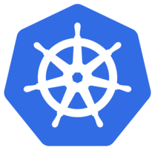


Agenda
Canary Deployment
K8s Cluster
Helm Installation
Istio Installation

Slide 5
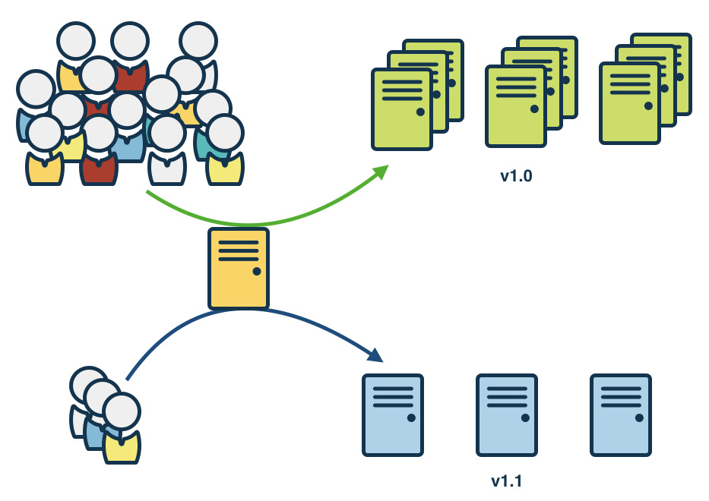
Deployment Strategy : Canary Release
Image Credit - www.gocd.org blog post

Slide 6
How Do We Do Canary Deployments?
Using Load balancers and Auto Scaling groups
kubernetes cluster:
Using Labels and Deployments
Using Istio service mesh

Slide 7
Canary Deployment
K8s Cluster
Helm Installation
Istio Installation

Slide 8
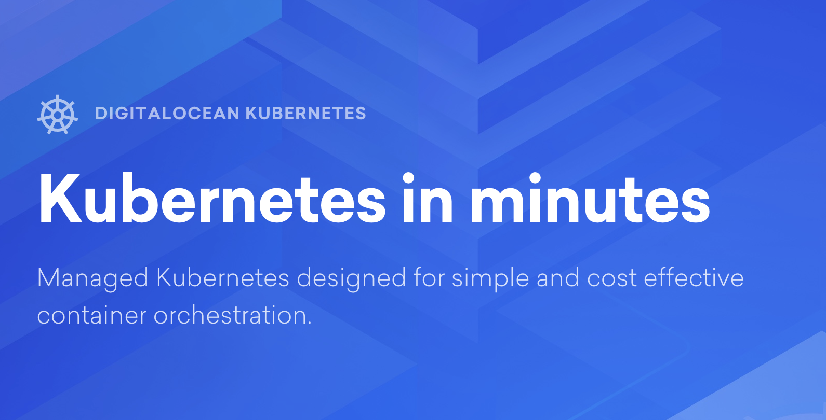
https://do.co/dockermeetup

Slide 9
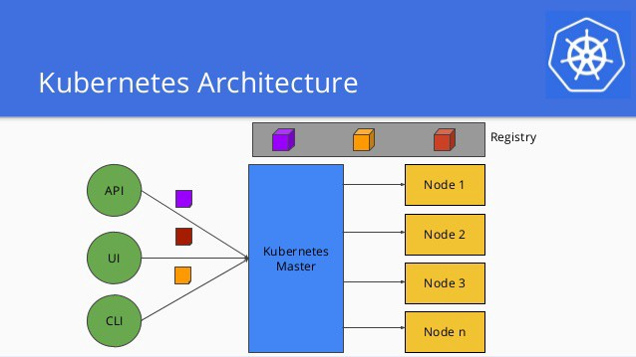

Slide 10
Canary Deployment
K8s Cluster
Helm Installation
Istio Installation

Slide 11
What is Helm?
Package manager for Kubernetes
Like apt, yum
Makes app deployment easy
Provides ease in managing apps

Slide 12
Helm components
Helm Client
Command line interface
Development of charts
Interaction with Tiller server
Tiller server
Interacts with Helm client and Kubernetes API server
Manages lifecycle

Slide 13
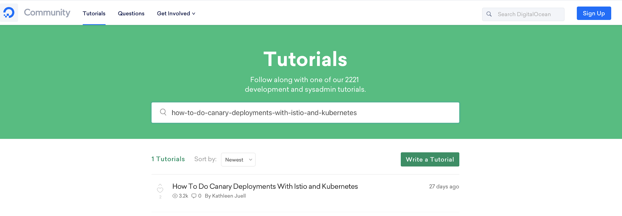
Community Tutorials
https://www.digitalocean.com/community/tutorials

Slide 14
Install Helm
https://www.digitalocean.com/community/tutorials/how-to-install-software-on-kubernetes-clusters-with-the-helm-package-manager

Slide 15
Canary Deployment
K8s Cluster
Helm Installation
Istio Installation

Slide 16
Istio
Service mesh providing for microservices platform
Traffic management
create a network of deployed services with load balancing, service-to-service authentication, monitoring and much more

Slide 17
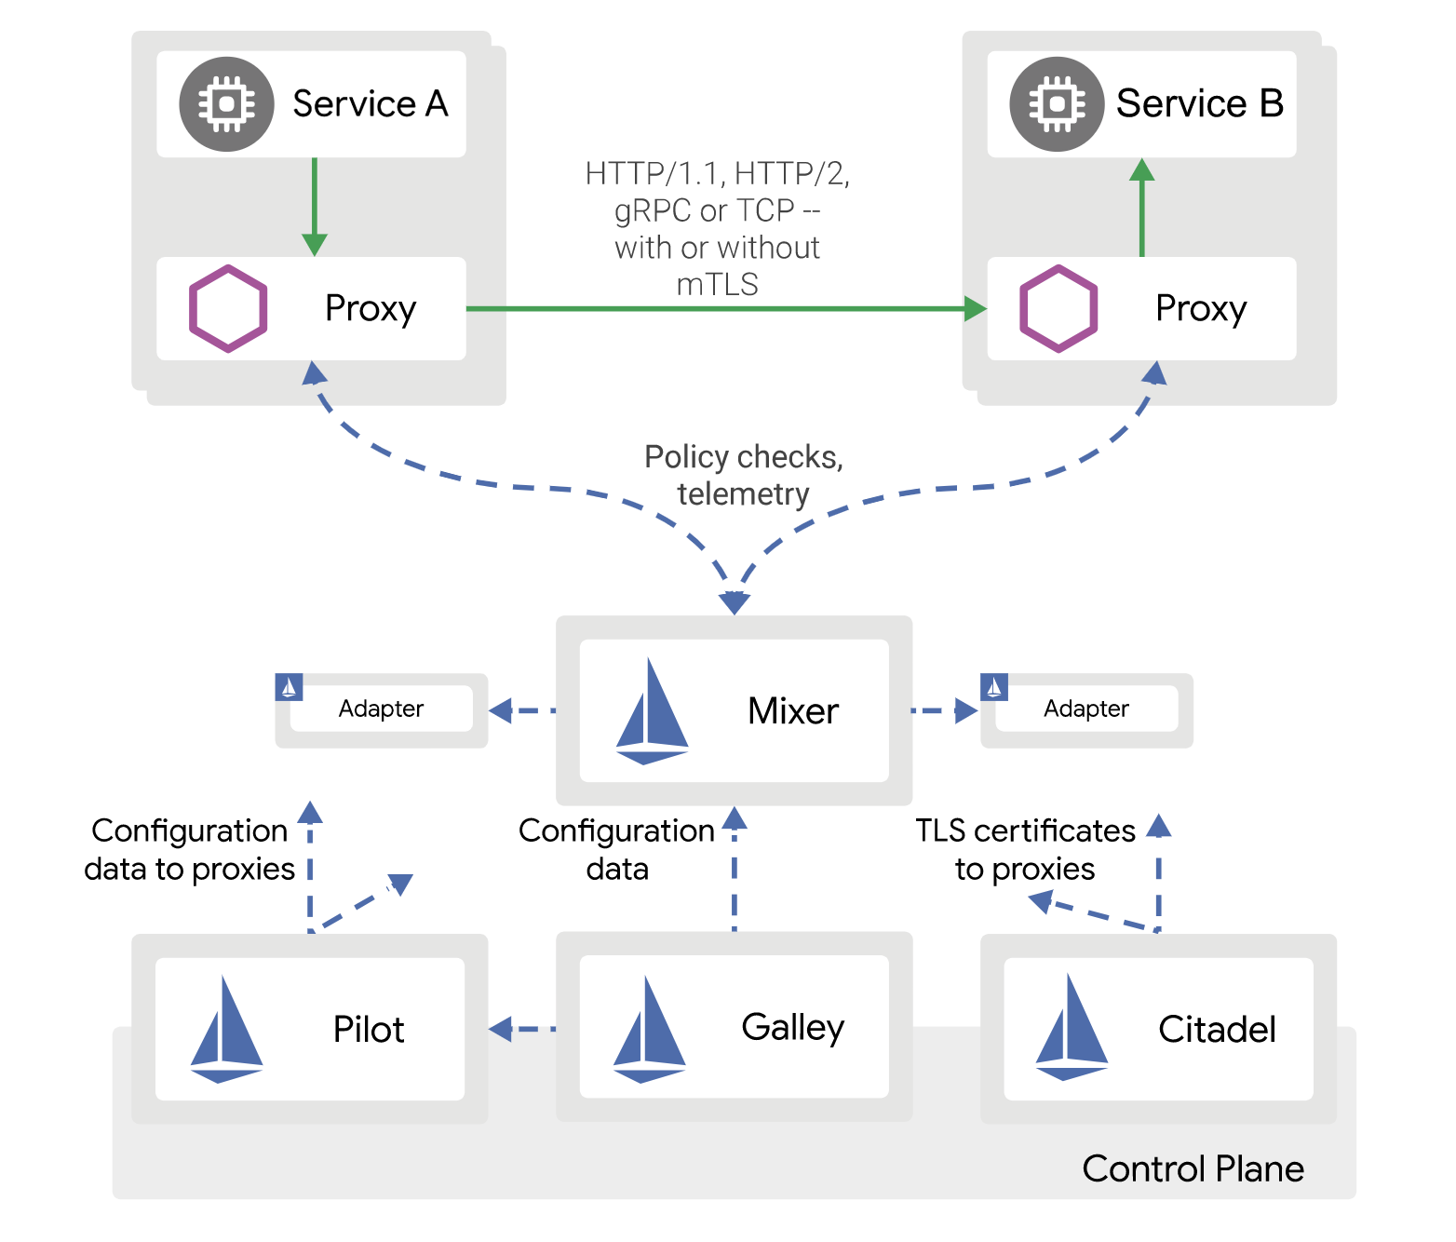
Istio Architecture
Image Credit - Istio.io docs

Slide 18
Advantages of Istio
Service discovery
Load balancing
Traffic routing and control

Slide 19
Traffic Management with Istio
Istio’s traffic management model relies on the following two components:
Pilot : The core traffic management component.
Envoy proxies: which enforce configurations and policies set through Pilot.

Slide 20
Traffic Management API resources
Virtual services
Destination rules
Gateway
Sidecar container

Slide 21
Install Istio with Helm
https://www.digitalocean.com/community/tutorials/how-to-install-and-use-istio-with-kubernetes

Slide 22
Canary Deployment
K8s Cluster
Helm Installation
Istio Installation

Slide 23
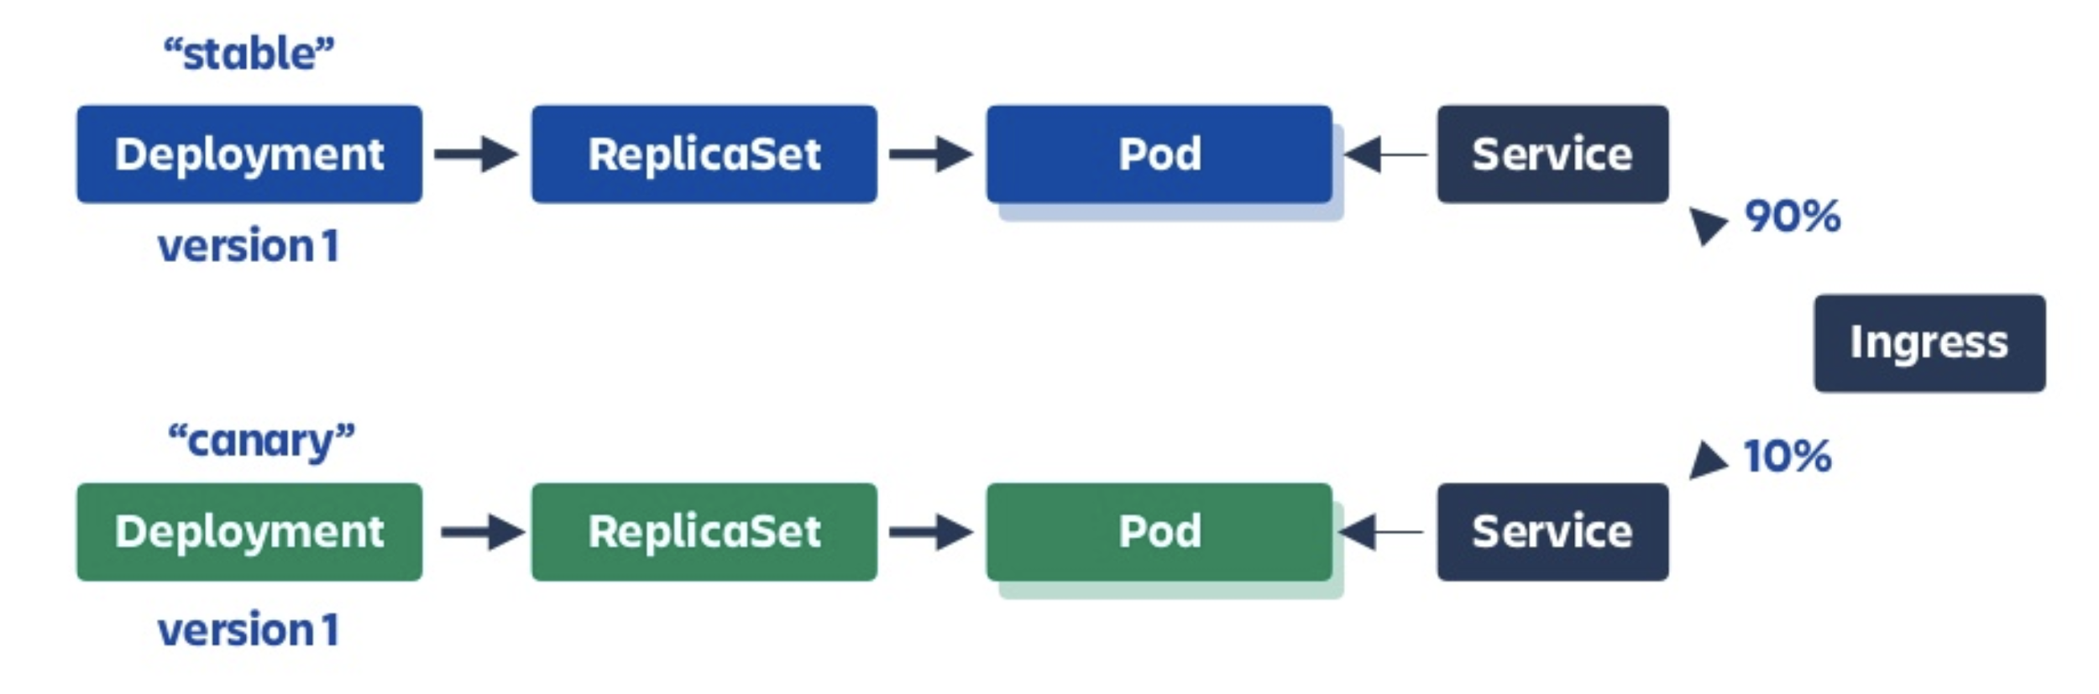

Canary Deployment
https://www.digitalocean.com/community/tutorials/how-to-do-canary-deployments-with-istio-and-kubernetes

Slide 24



Mamta Jha
@im_mamtajha
digitalocean.com

Slide 25


Slide 26
Thank you!

